Slide 1
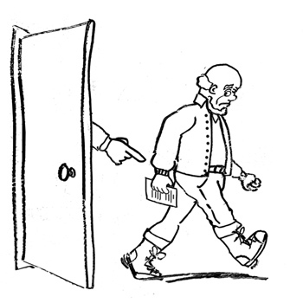
Notes:
Image used in 100.1

Slide 2

Notes:
Alternate with more desperate expression. Did not use.

Slide 3
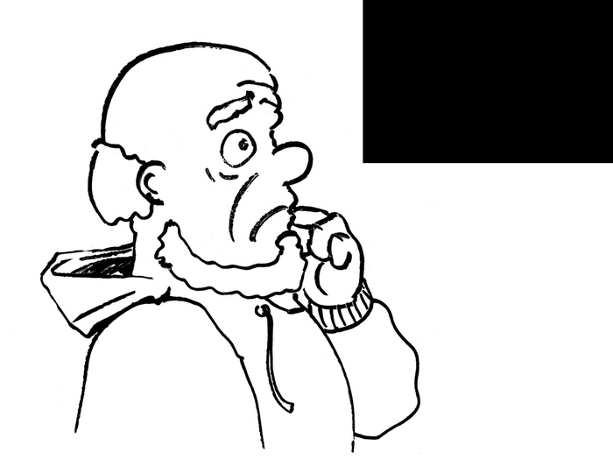
Notes:
Confused / bemused guy looking UP

Slide 4
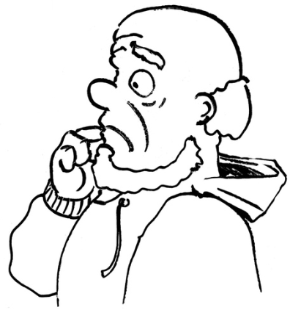
Notes:
Confused / bemused guy looking DOWN

Slide 5
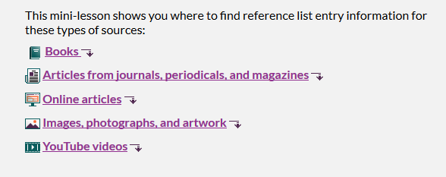
Icons are in the Citations embedded graphics directory
Close thumbnail
Open thumbnail

Slide 6
Furtherdown and linkout are in the embedded graphics main directory

Slide 7
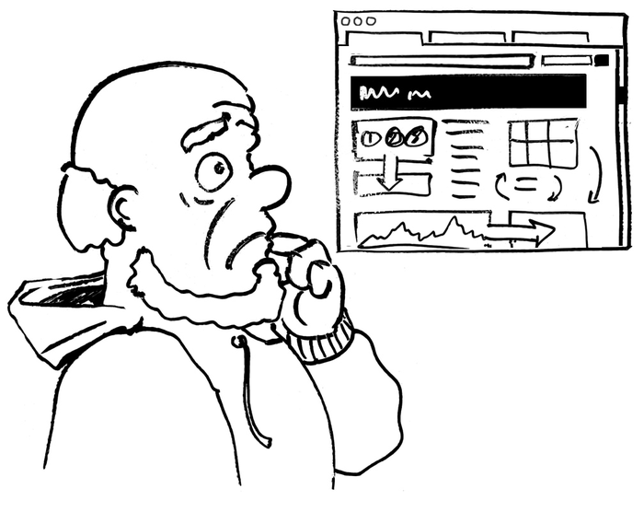
Notes:
B&W website

Slide 8
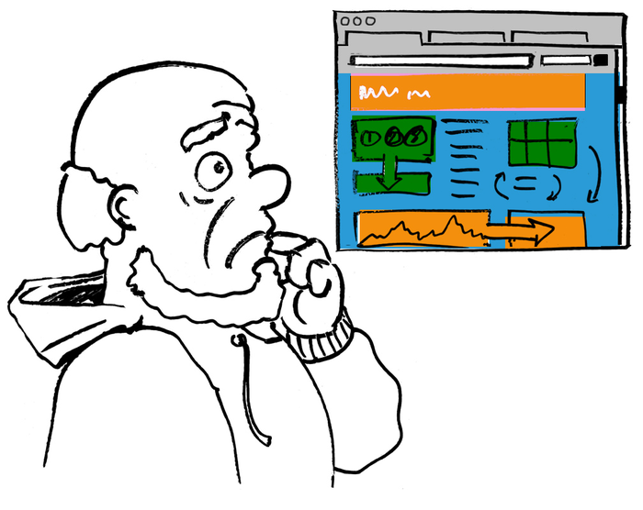
Notes:
Color website

Slide 9

Notes:
Scrap of paper

Slide 10
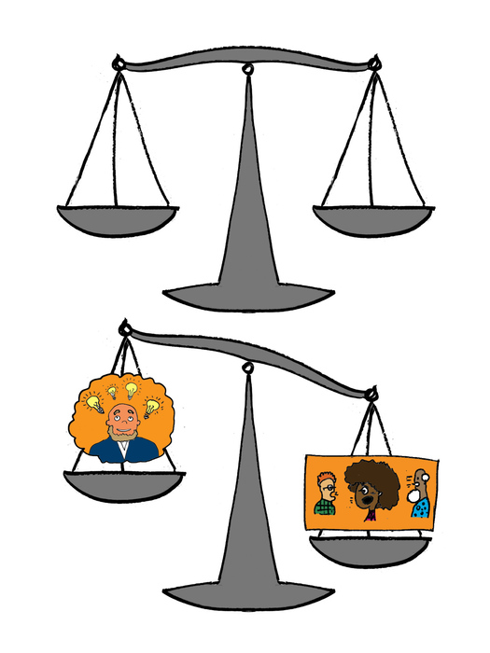
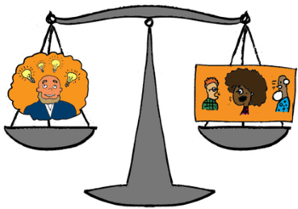
Notes:
Balancing ideas. Note: We used the version with a balanced scale instead. Betsy made that version from the one supplied by ifactoryusing paint.net

Slide 11
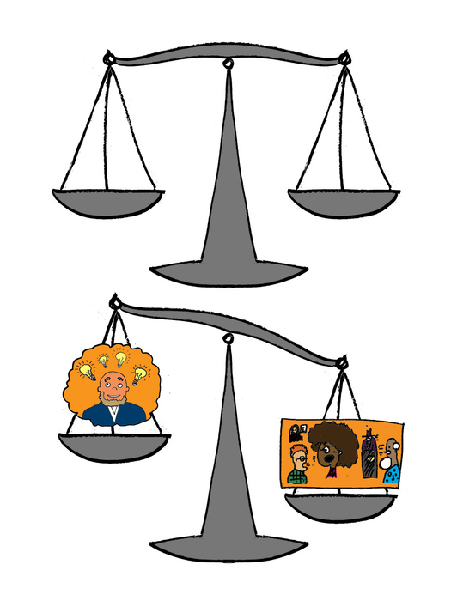
Notes:
Alt: Balancing ideas with more sources. Did not use.

Slide 12
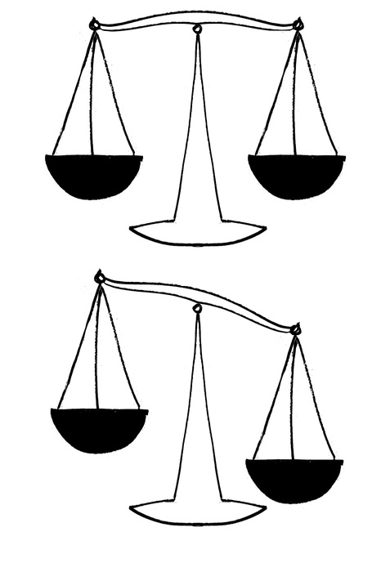
Notes:
Empty scales for balancing writing.

Slide 13
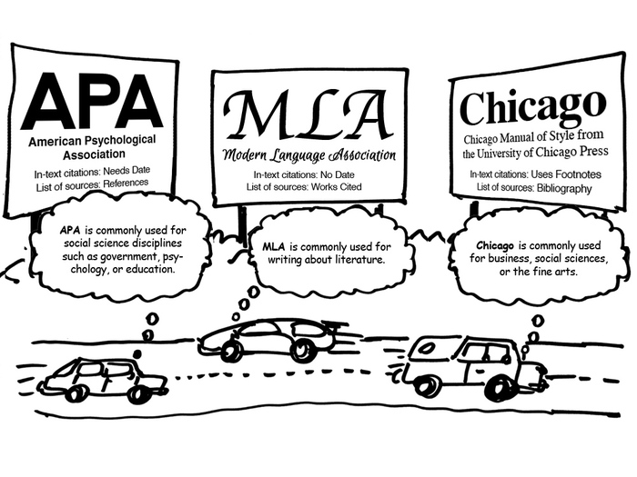
Notes:
Different styles

Slide 14
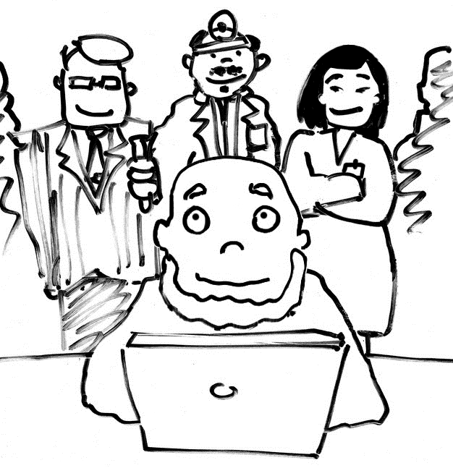
Notes:
Why cite? Show that exports support your ideas

Slide 15
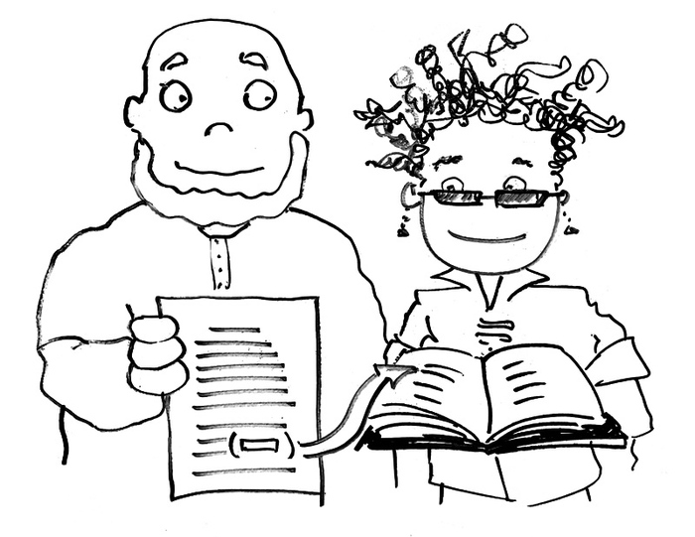
Notes:
Why cite? Readers can follow up

Slide 16
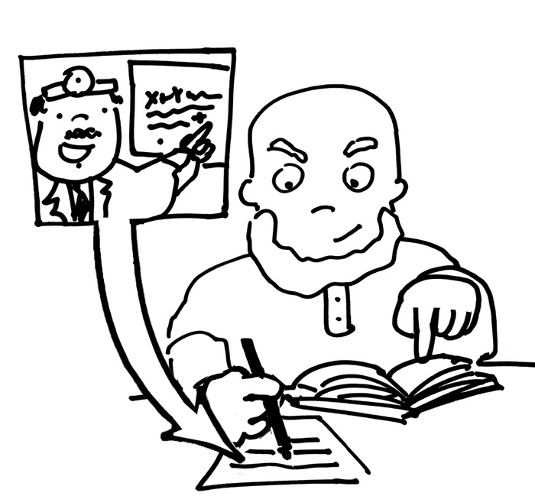
Notes:
Why cite? Identify words and ideas of others

Slide 17
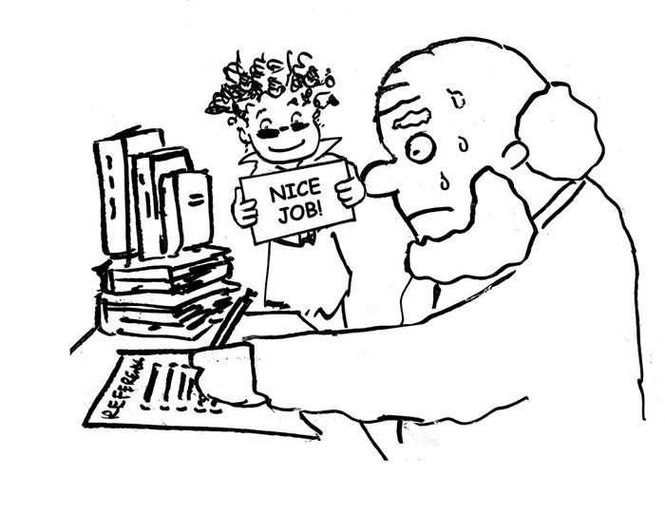
Notes:
Why cite? Show off hard work

Slide 18
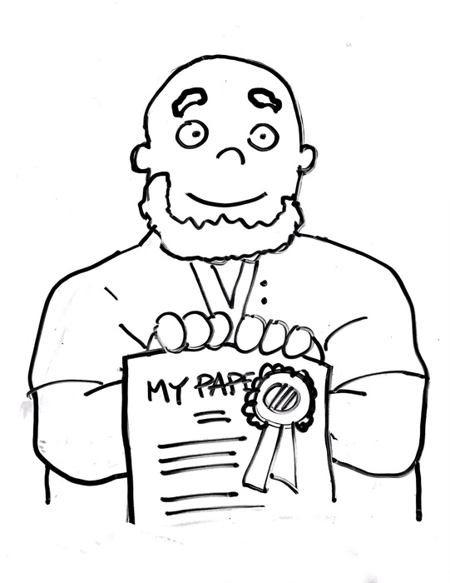
Notes:
Why cite? Avoid plagiarism

Slide 19
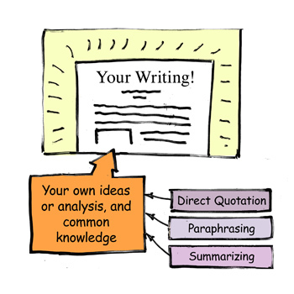
Notes:
Your writing as a combination

Slide 20
Notes:
Your writing as a combination

